Slide 1
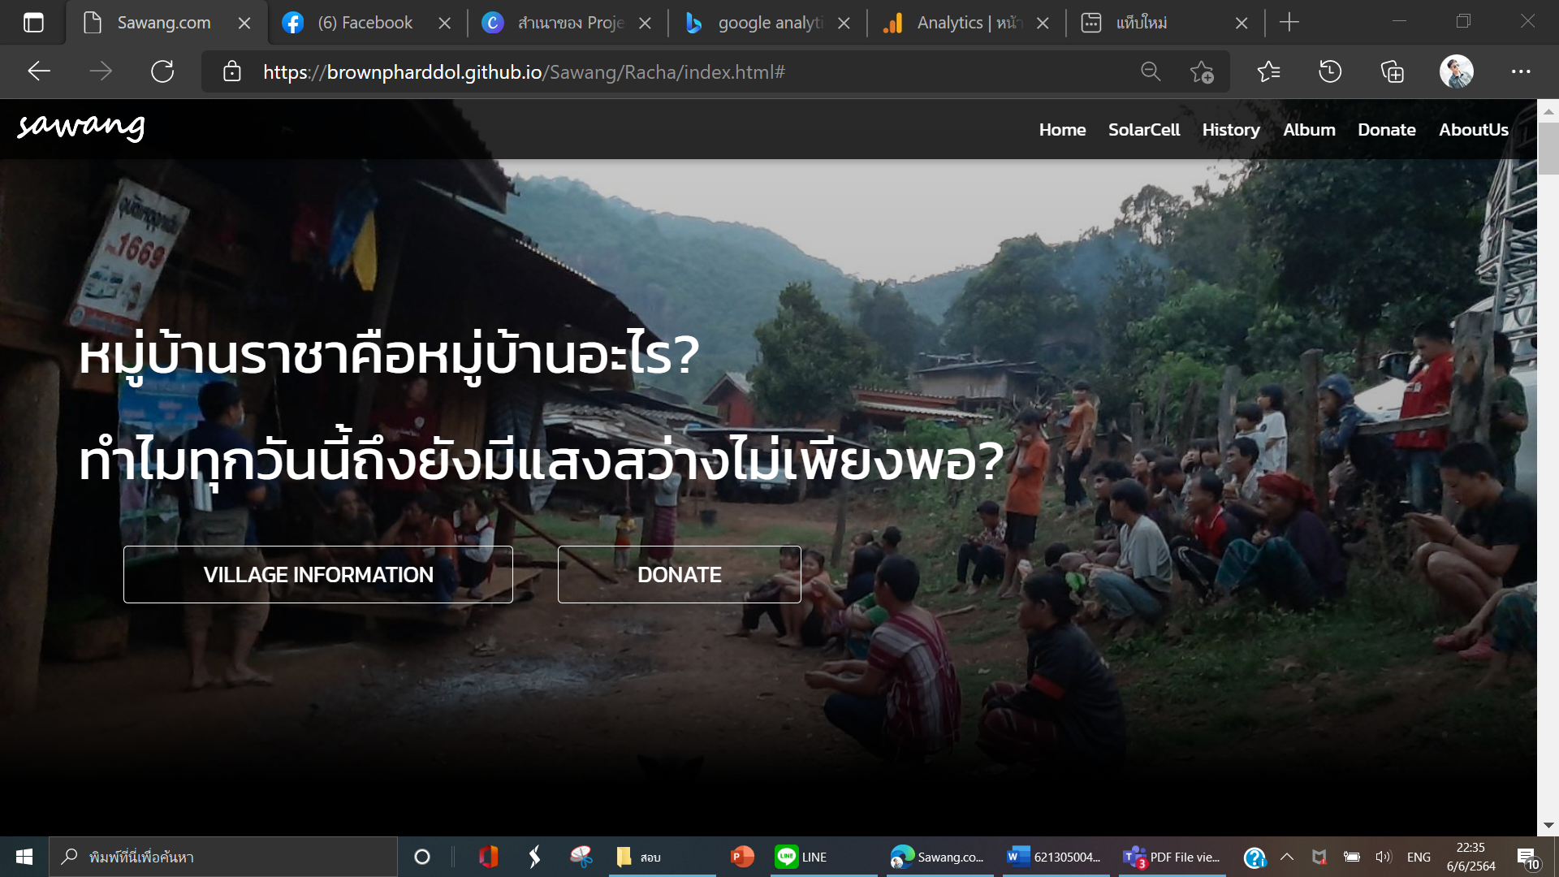
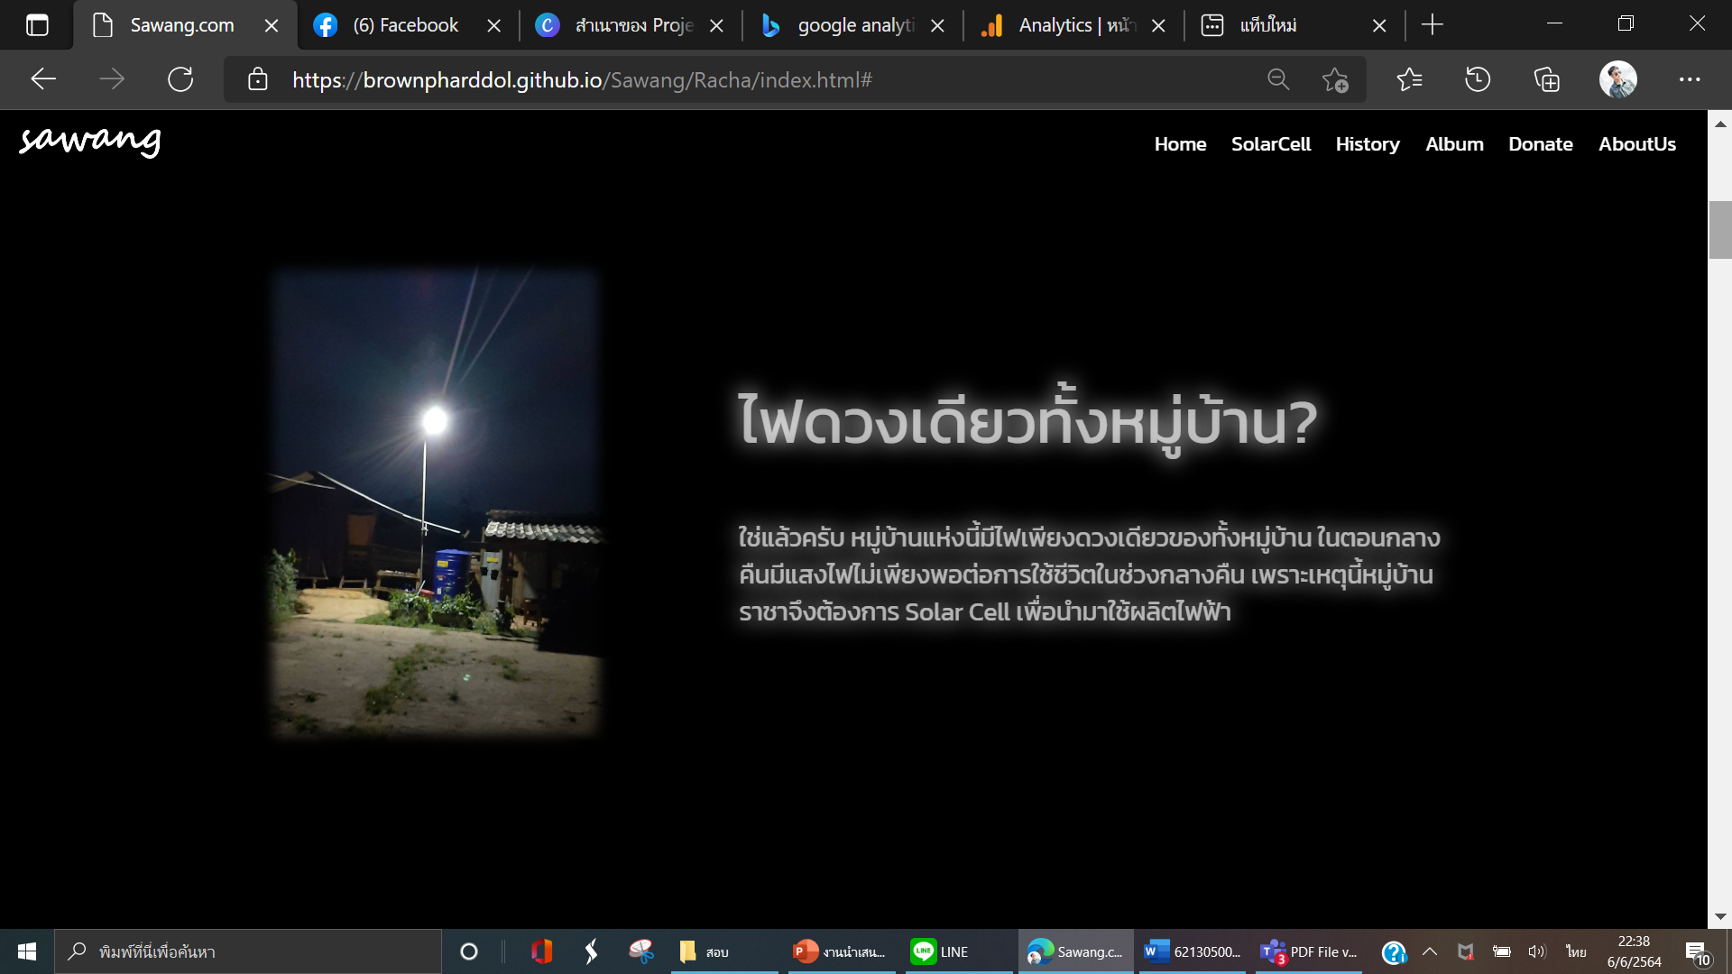
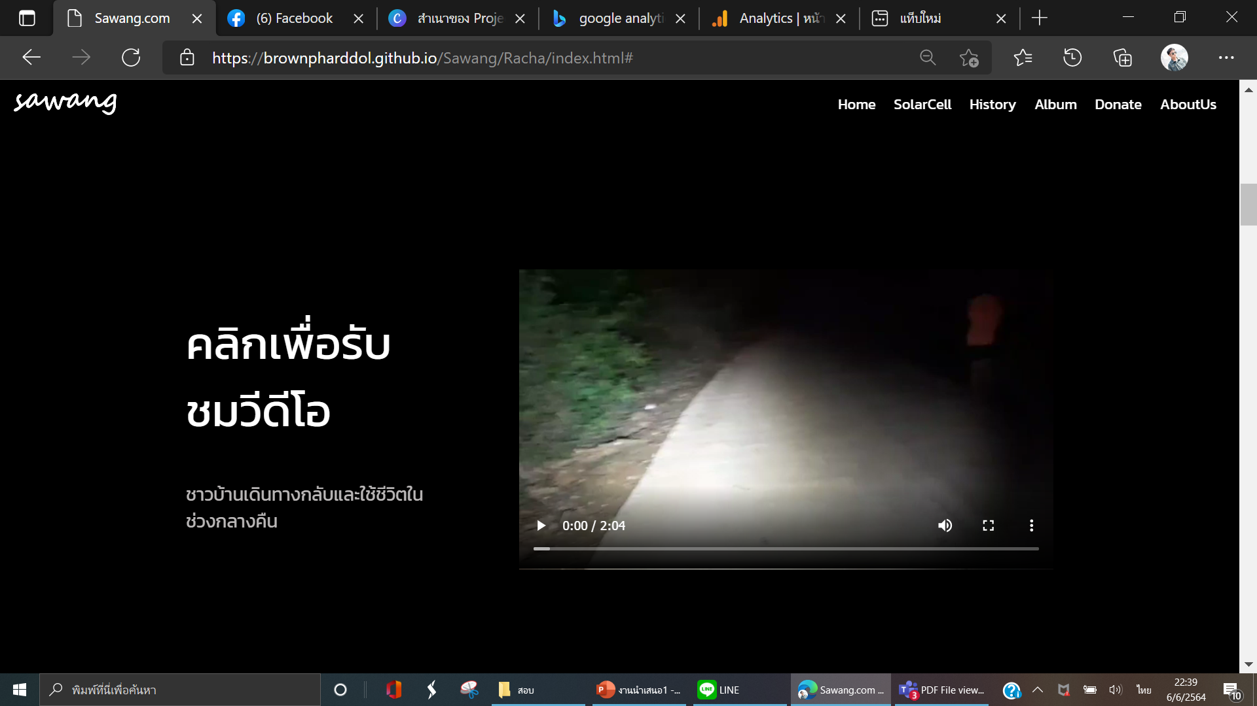
<img>
<ul>
<li>
< nav class=“menu-bar”>
<flex>
<h1>
<div>
<h1>
<a>
<a>
<div>
< section class = “con1 ”>
< section class = “con 2 ”>
<div class=“con2-part1”>
<img>
<h2>
<div>
<p>
<div class=“con2-part2”>
<div>
<video>
<h2>
<p>

Slide 2
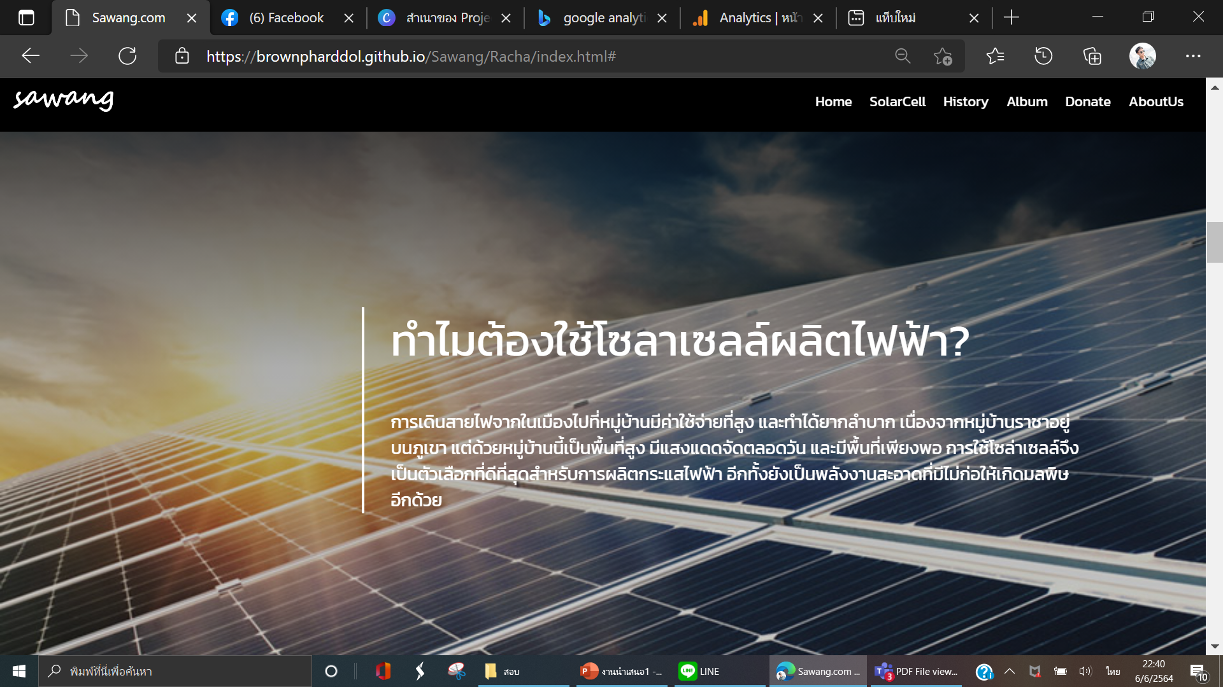
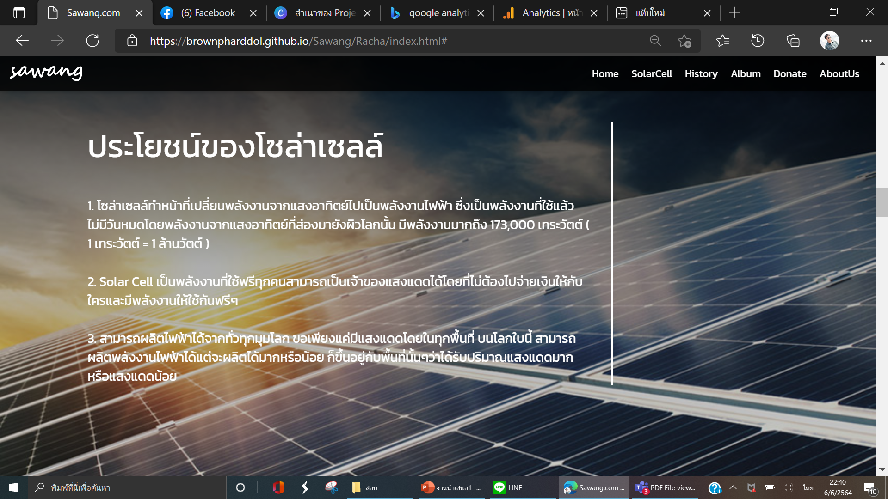
< section class = “con3 ”>
<flex>
<h2>
<div>
<p>
<flex>
<h2>
<div>
<p>
< section class = “con3 ”>

Slide 3
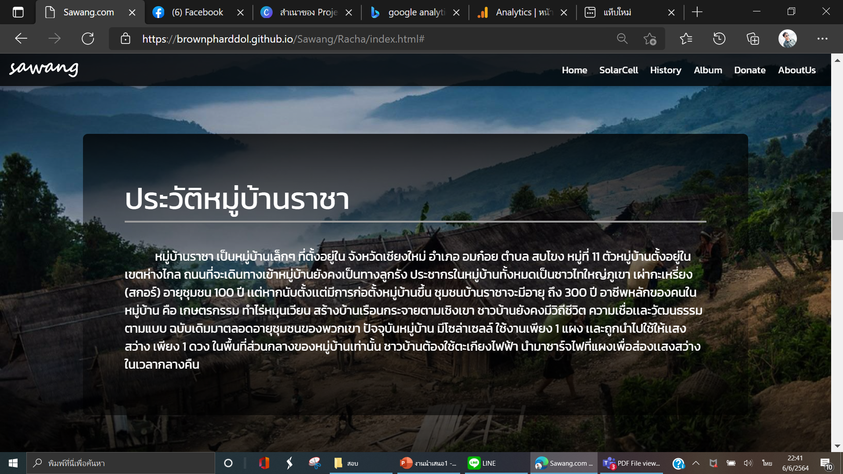
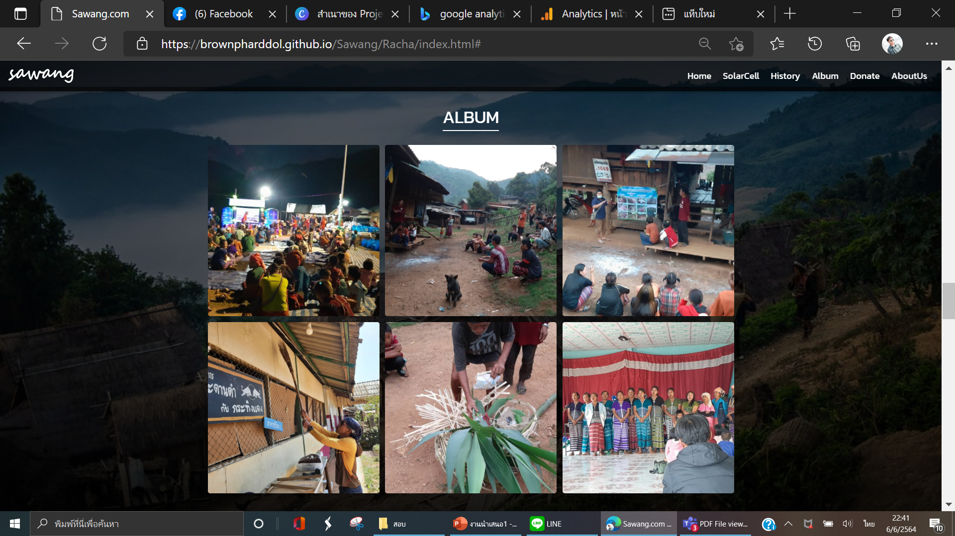

<div class=“con4”>
< section class = “big-container ”>
<h2>
<p>
< section class = “big-container ”>
<h2>
<grid>
<img>
<img>
<img>
<div
class=
“con5”>
<img>
<img>
<img>
<flex>
< section class = “big-container ”>
<flex>
<div class=“con5”>
<h2>

Slide 4

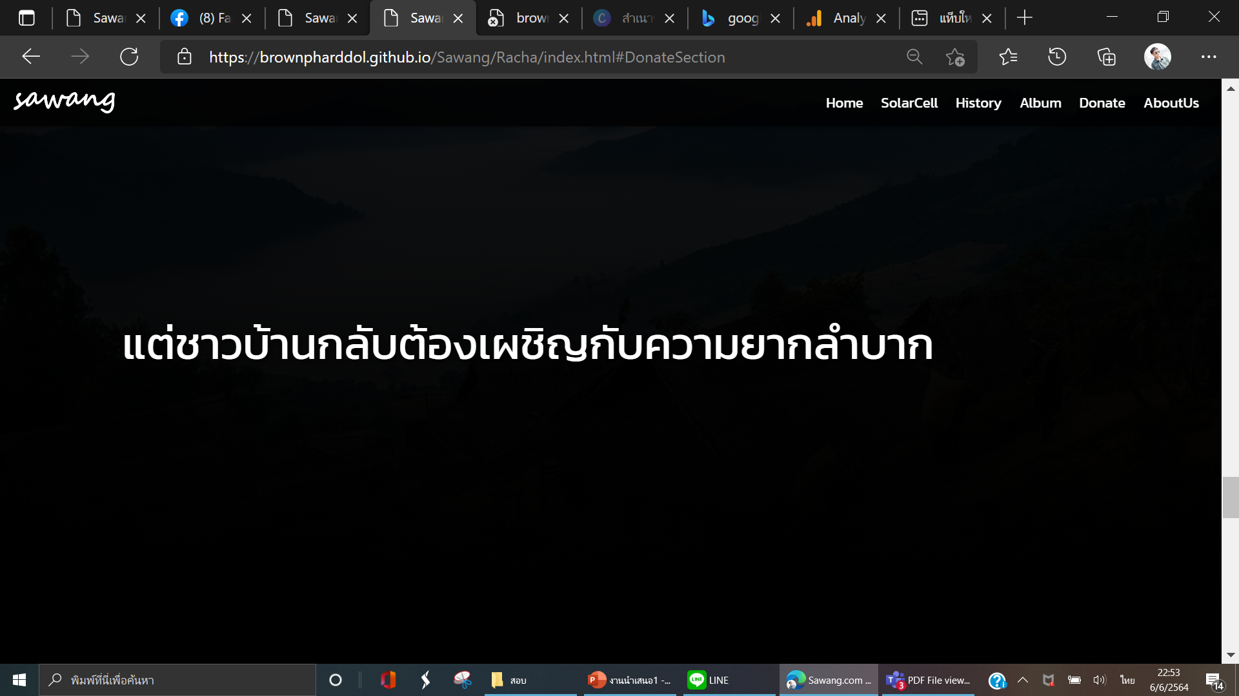
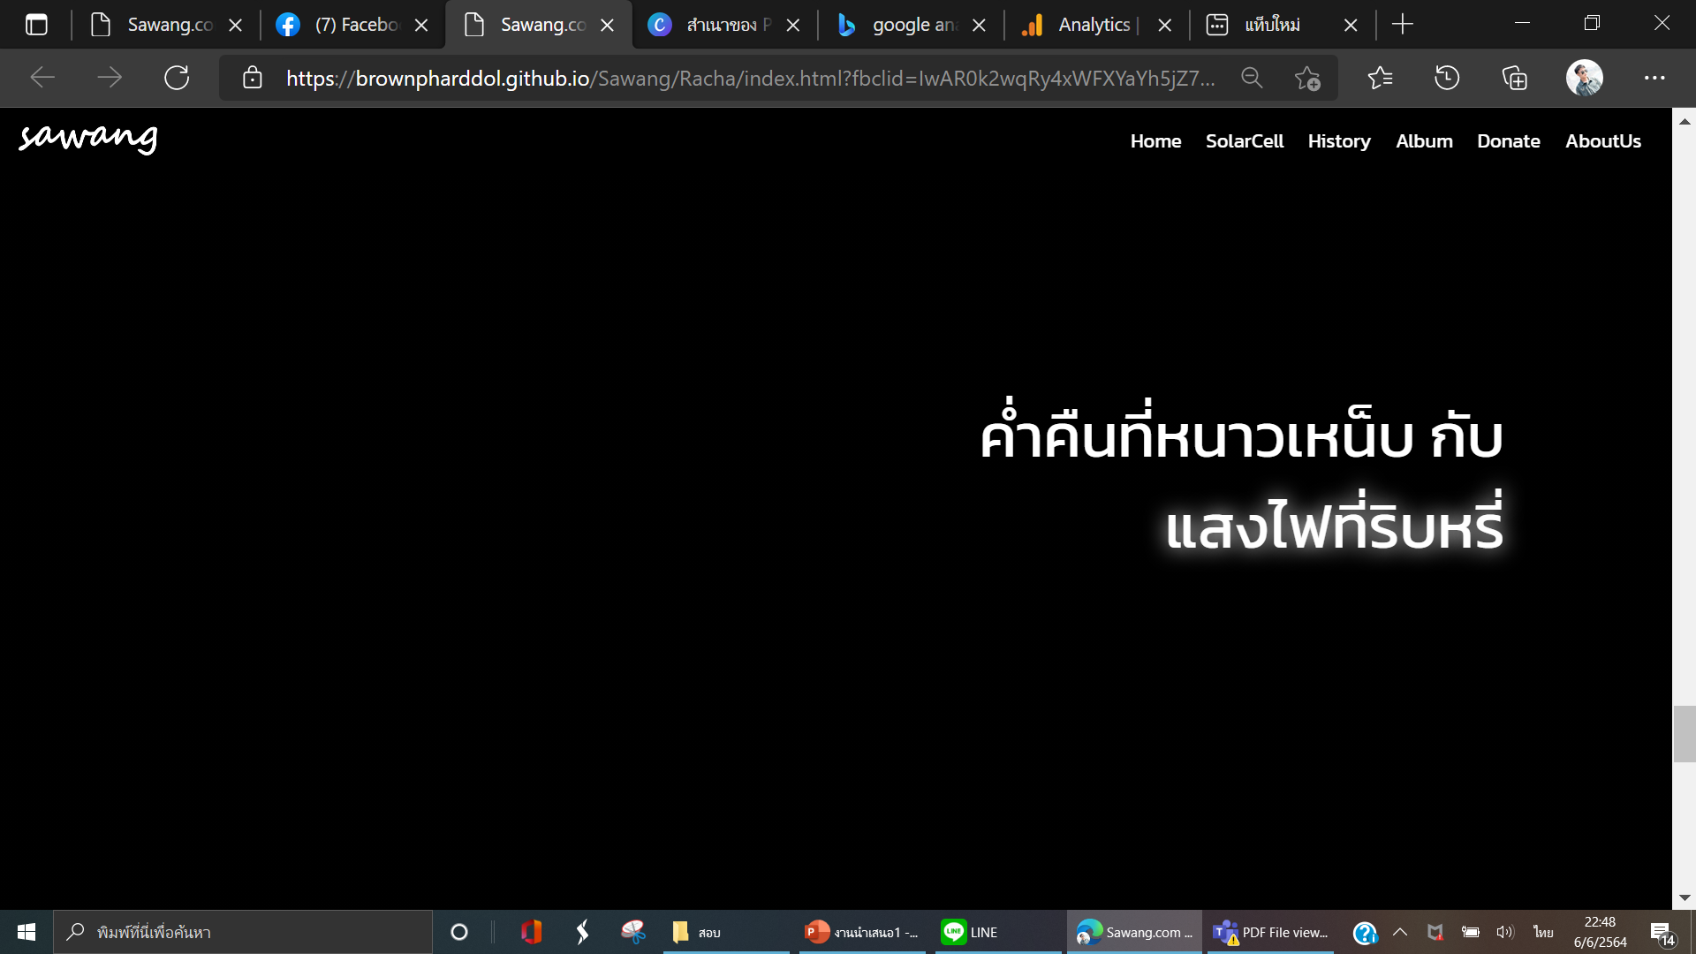
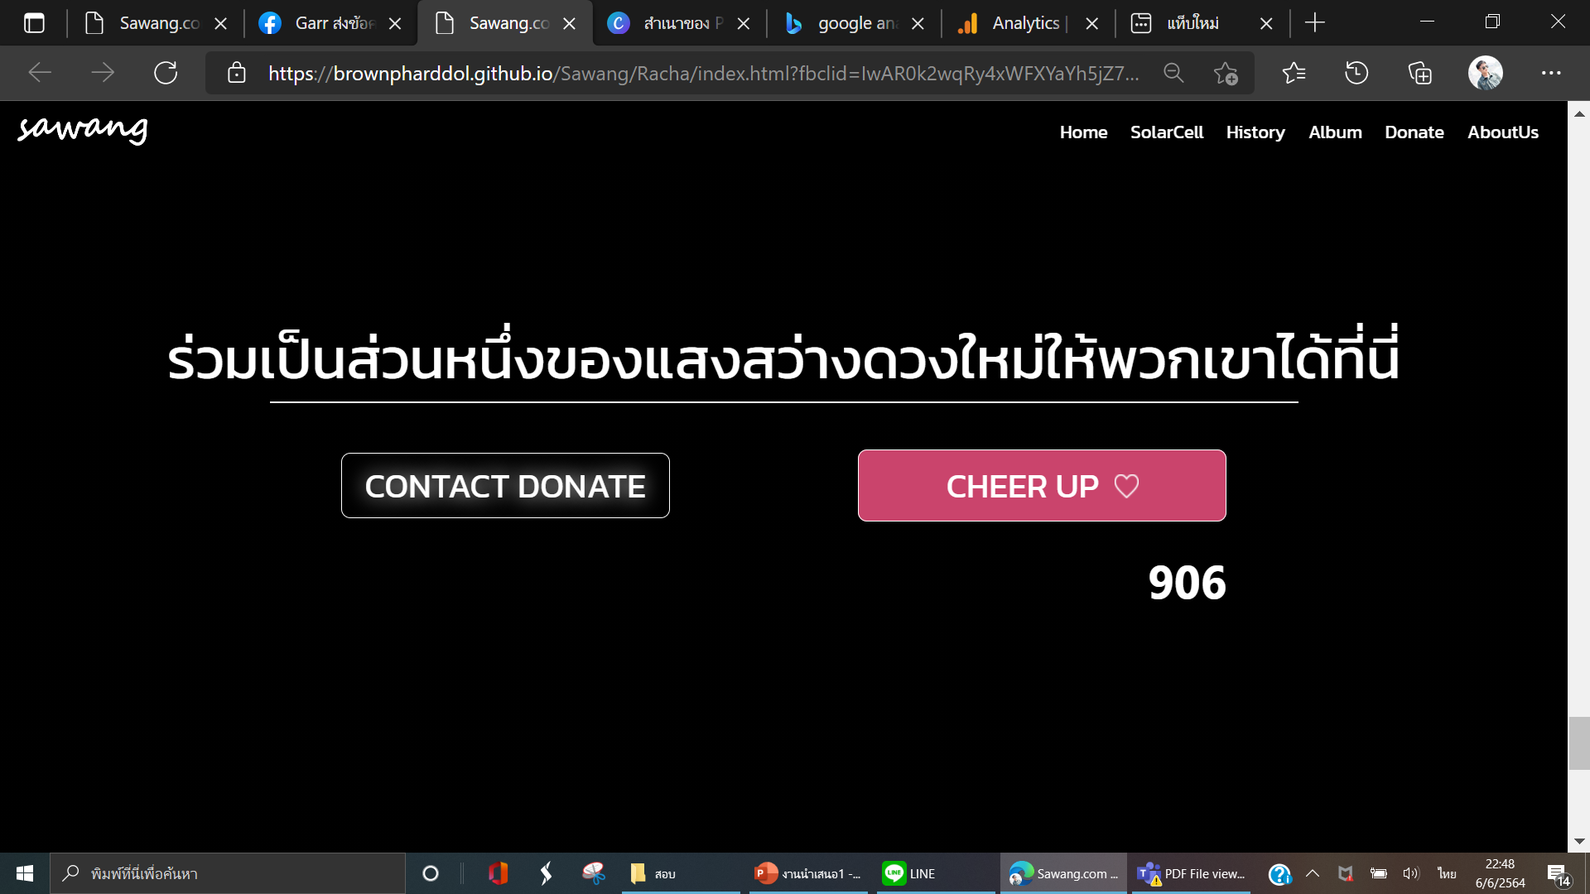
< section class = “big-container ”>
<flex>
<section class=“con5”>
<h2>
<h2>
<h2>
</div>
<section class=“con6”>
<div>
<h1>
<a>
<a>
<h2>

Slide 5
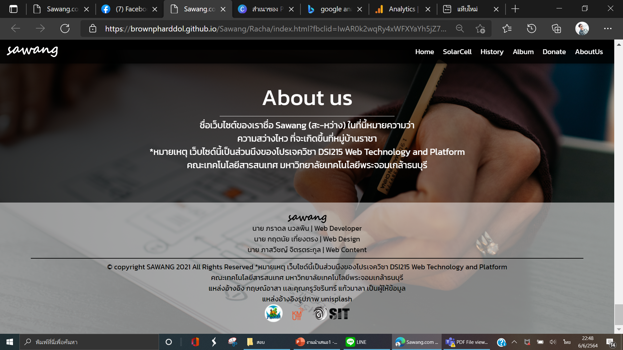
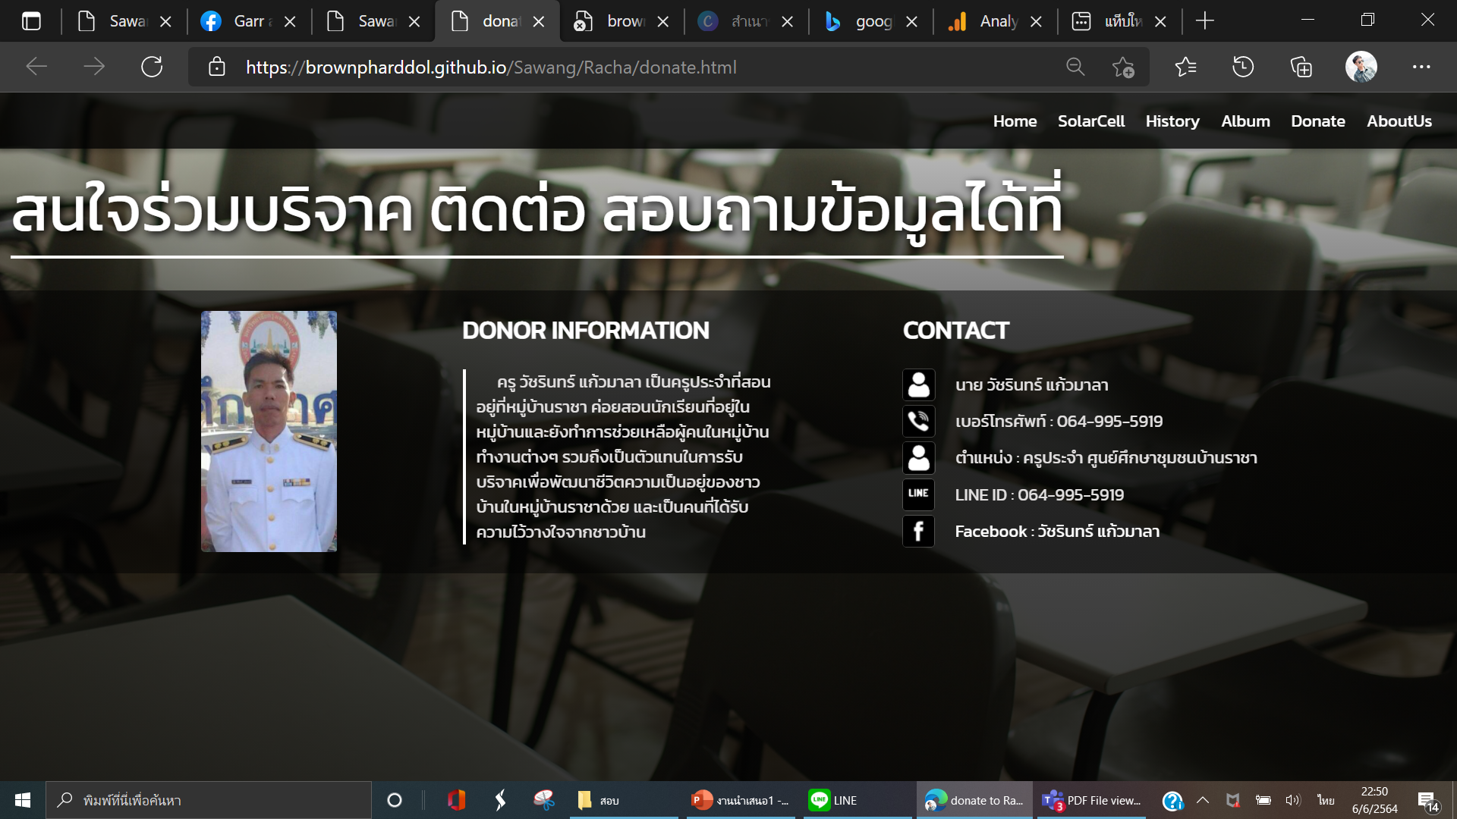
< section class = “bg7-8 ”>
<section class=“con7”>
<h2>
<p>
<div>
</p>
<section class=“con8”>
<img>
<p>
</p>
<div>
<p>
<img>
</p>
<flex>
<h1>
<p>
<h2>
<h2>
<div>
<li>
<li>
<div>
<li>
<ul>
<img>
<li>
</p>
<img>
<li>
<section class=“donate”>
<flex>
<section class=“bg-donate”>

